Slide 1
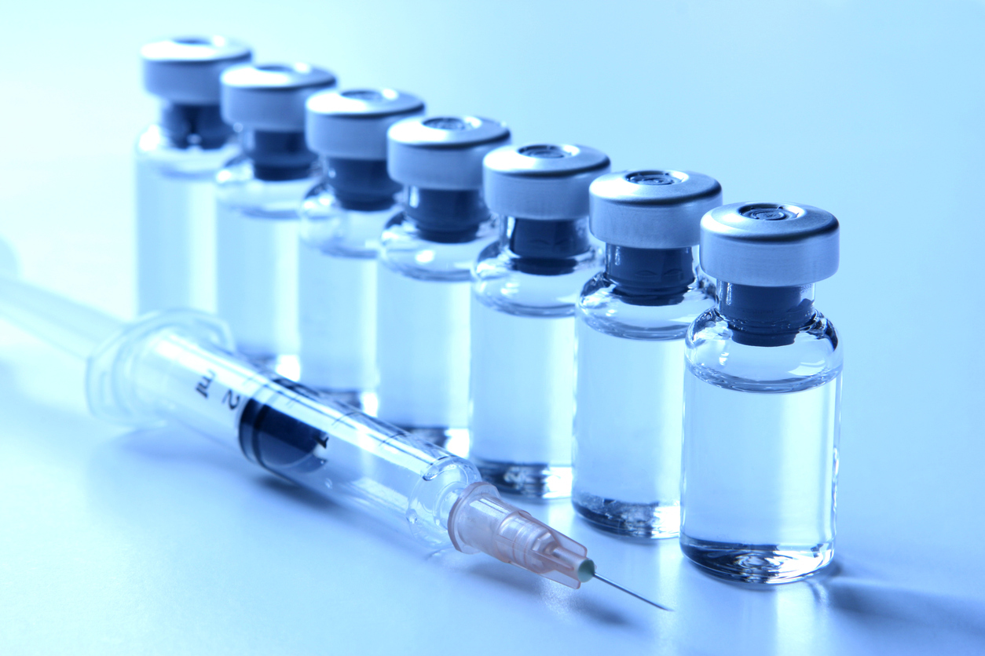
Real Life Lab(RLL) Project Online Vaccine Management

Slide 2

Presented By:-
Peteti Akhil Kumar-2586858
Prashant Bhajantri-2587418
Priyanka O-2587712
Rachagalla Madhavi-2587656
Ramya Daphalapur-2587654
Reby Royan Balraj-2587309
Rohini Vilas Khot-2587114
Satyendra Sharma- 2586787

Slide 3
MODULES
Name | Domain | Module
Peteti Akhil Kumar | FSD | User Dashboard
Prashant Bhajantri | FSD | Certification and history
Priyanka O | FSD | AdminUser
Rachagalla Madhavi | FSD | Userhome and Welcom page
Ramya Daphalapur | FSD | SignUp and ResetPassword
Reby Royan Balraj | FSD | AdminSlot
Rohini Vilas Khot | FSD | AdminDashboard and AdminHome
Satyendra Sharma | FSD | Signin

Slide 4
Abstract
Introducing an innovative online vaccination management application designed to streamline and optimize vaccination processes.
This comprehensive platform offers appointment scheduling, vaccine inventory management.
User-friendly interfaces and advanced technologies, the application promises to revolutionize vaccination management, promoting public health initiatives worldwide.

Slide 5
Introduction
The Online Vaccine Management Contains 2 parts
Admin
User
The Admin is responsible to add vaccine availability different locations.
And also admin is responsible for making the users to take Vaccine according to the slot timing.
User can book the slot for Vaccination by knowing the availability in the inventory.

Slide 6
Components
Welcome Page
Sign in
Sign Up
Admin Dashboard
Add Vaccination Details
Add User
Edit User
User Dashboard
Slot Booking
History
Certificate Download

Slide 7
Technologies Used:-
SpringBoot
Angular
MySQL
Postman
TestNG

Slide 8

Welcome Page
A Welcome page you can see when you reach the Url.

Slide 9
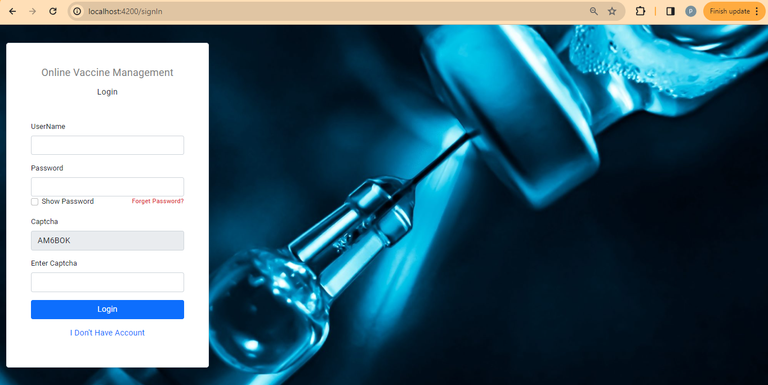
Sign In
When you click on the sign in we will get which will login to the Admin page when you give the Admin Credentials and login in to User Page when User Credentials Were given.

Slide 10
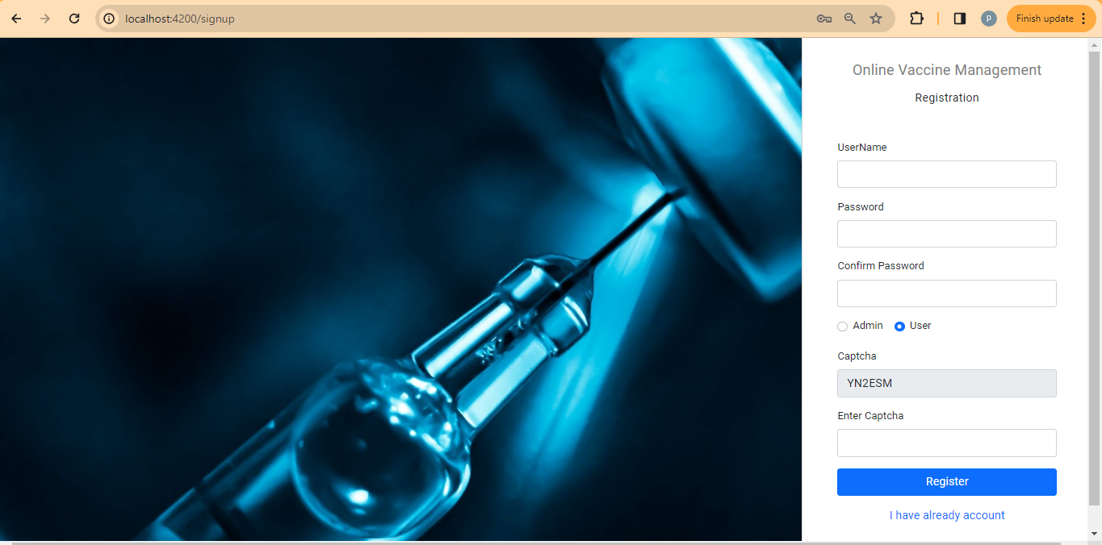
SignUp
When the user or admin want to create a new account then can create a account using valid credentials and if user select user radio button if admin select admin radio button and create the account.

Slide 11
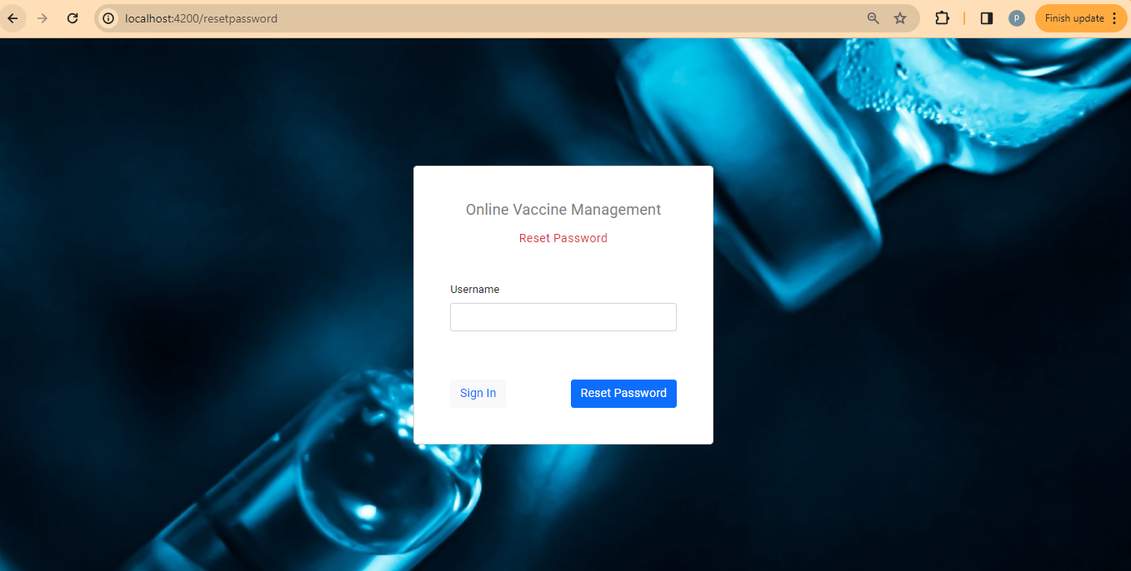
Forget Password
If the user or admin forget the password then can reset the password when the credentials were present in database and they can set new password.

Slide 12
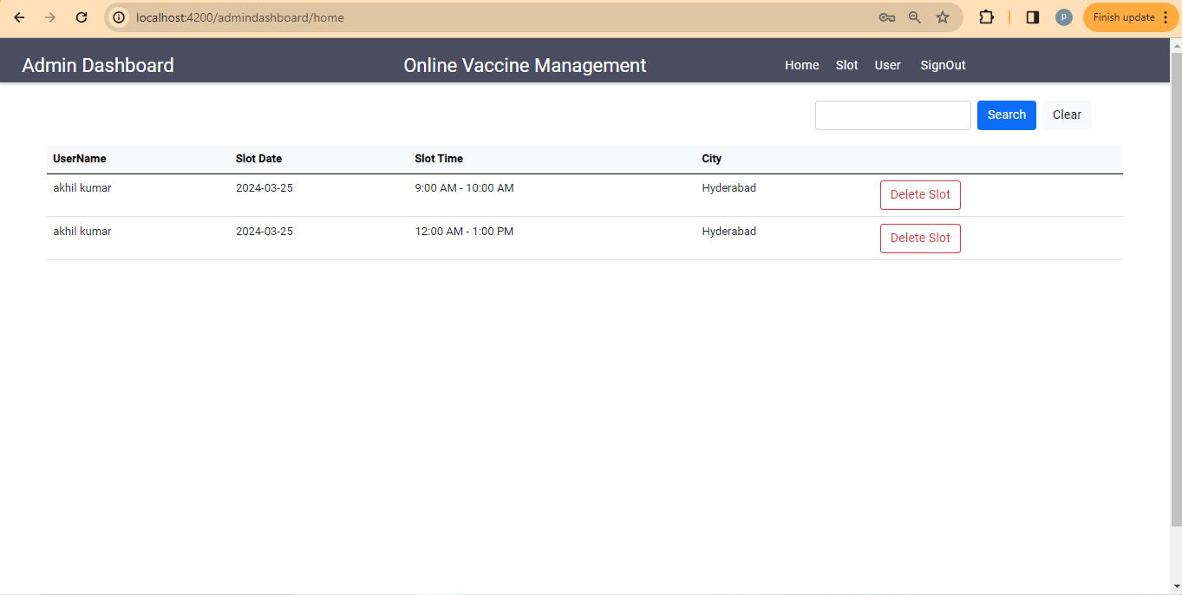
Admin Dashboard
After Signing in Successfully the User Dashboard will be displayed where it contains different navigation parts to slot setting and user controls. And also contains the users those who booked the slot for vaccination.

Slide 13
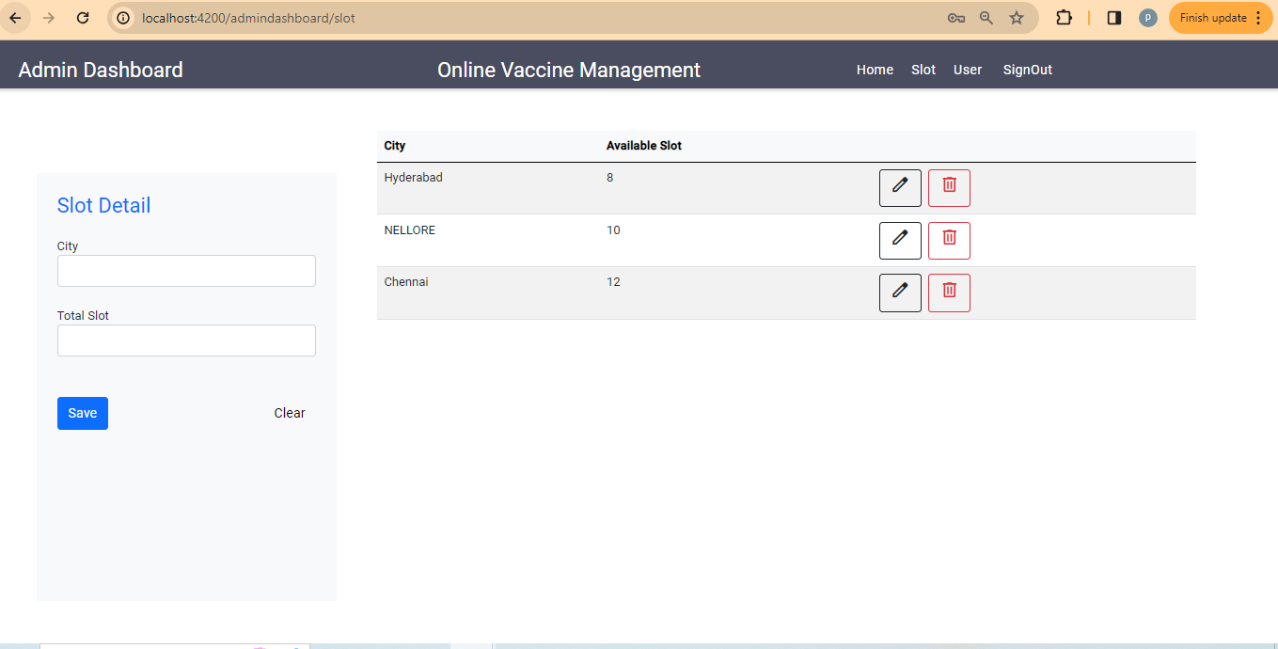
Admin Slot
The Admin Slot where the user include the slots for different locations and can check the slots that were included before.

Slide 14
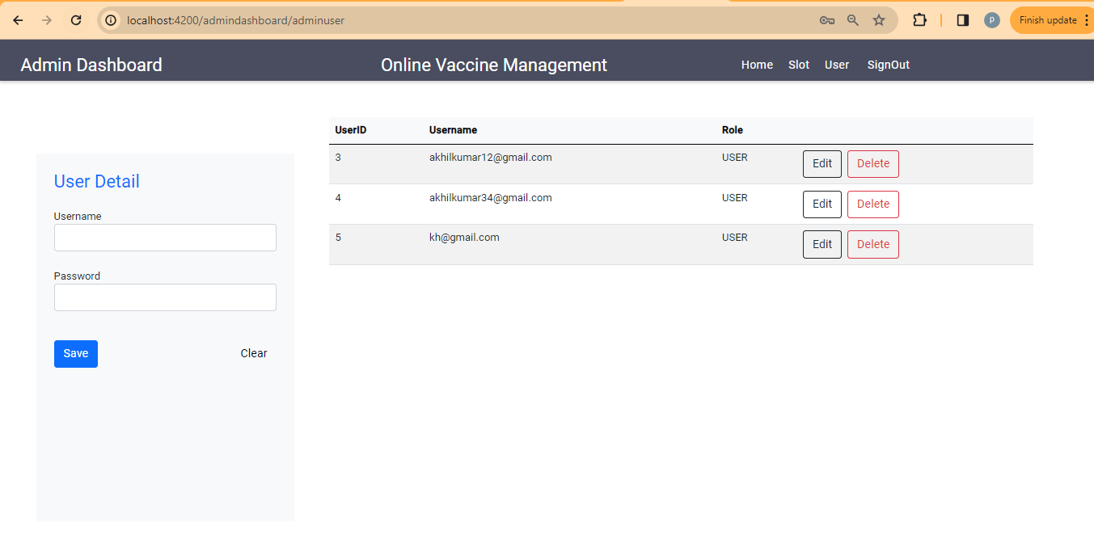
Admin User Details
The Admin user place where it shows the different users present in the database and admin can help the users to change the password as well can delete the user.

Slide 15
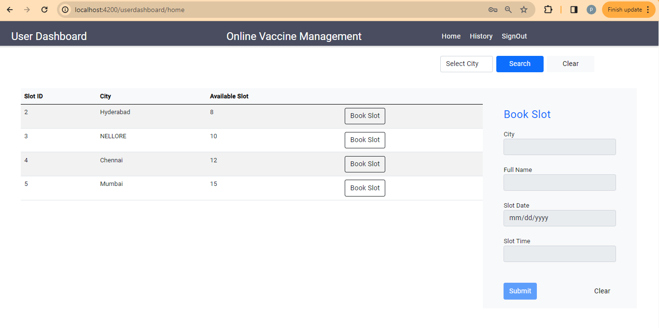
User Dashboard
The User dashboard where the users interact with the application to book the slot for the vaccination where the slots availability will be displayed.

Slide 16
User Home
User home where the user can book the slot and for them and for their parents if needed and based on the availability shown in the home page by selecting the city .

Slide 17
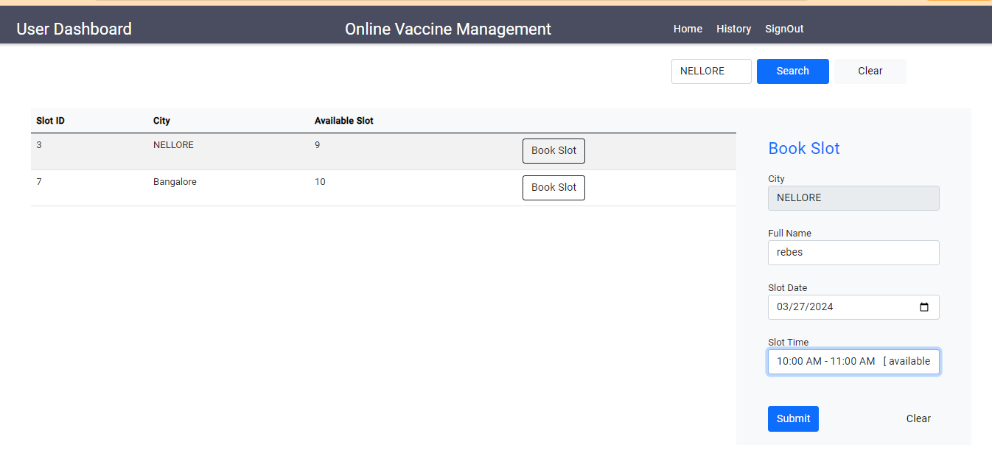
User Booking
The place where the user can book the slots according to the slot availability and get the data from the database by knowing the available slots.

Slide 18
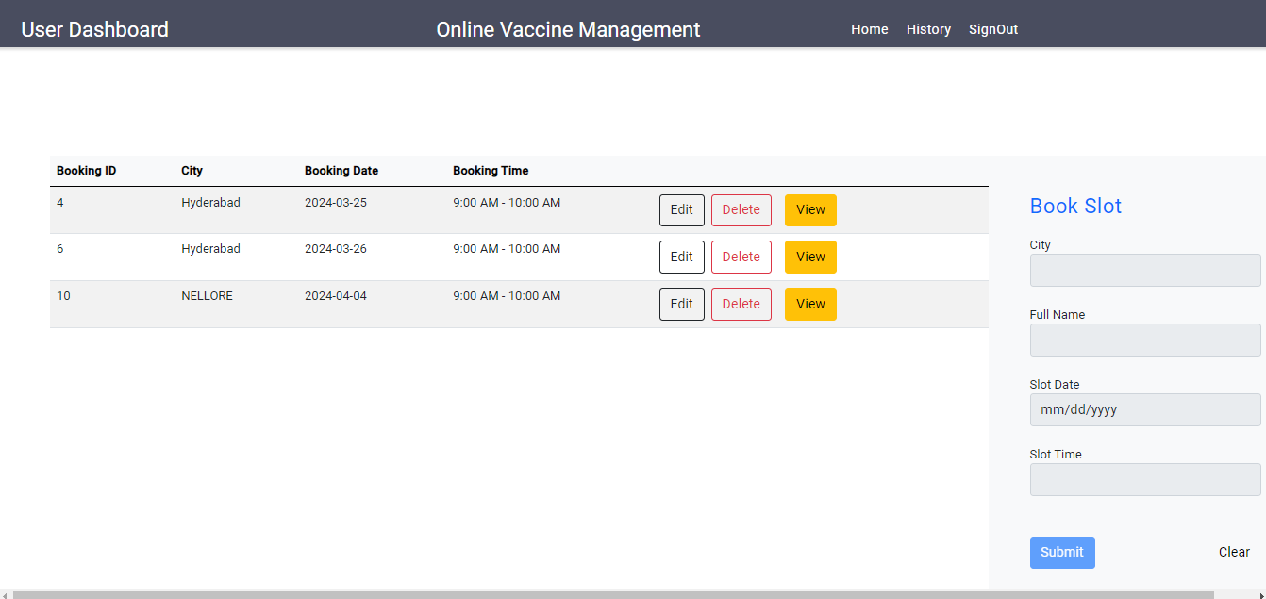
History
The History tab in the user will display the user transaction history where it contains their previous booking data.

Slide 19
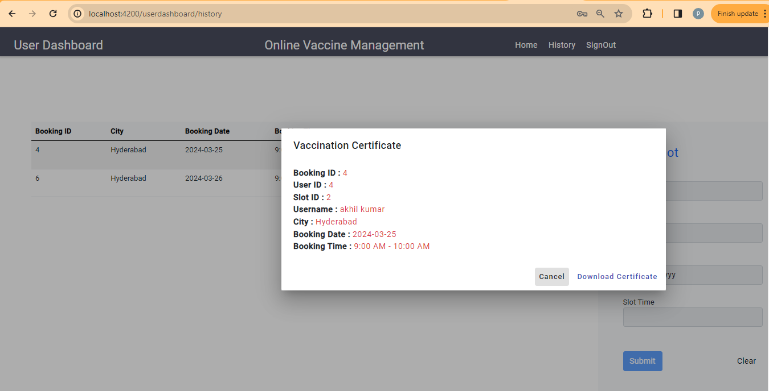
Download Certificate
The view button in the history tab contain download the certificate option which will download the certificate in the Pdf format.

Slide 20
The Postman Testing

Slide 21
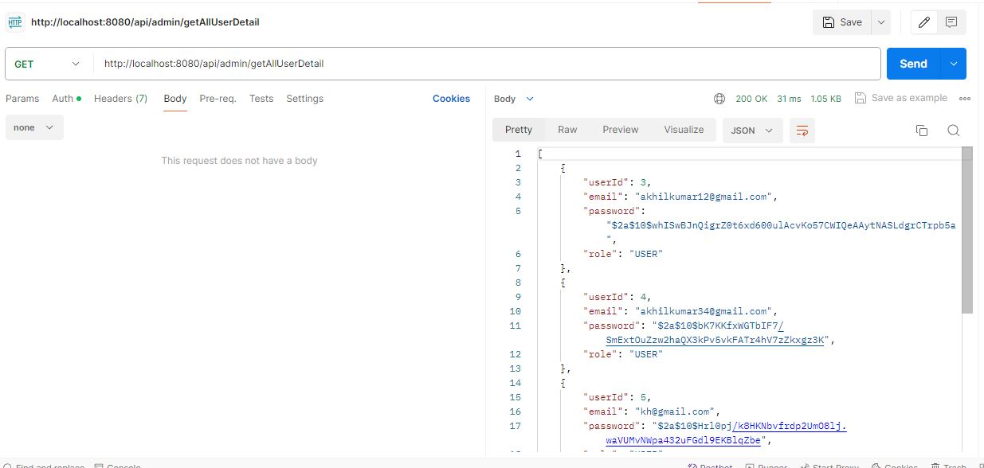

Slide 22
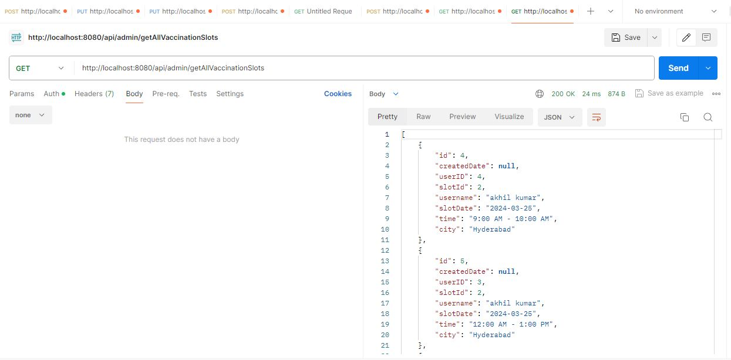

Slide 23
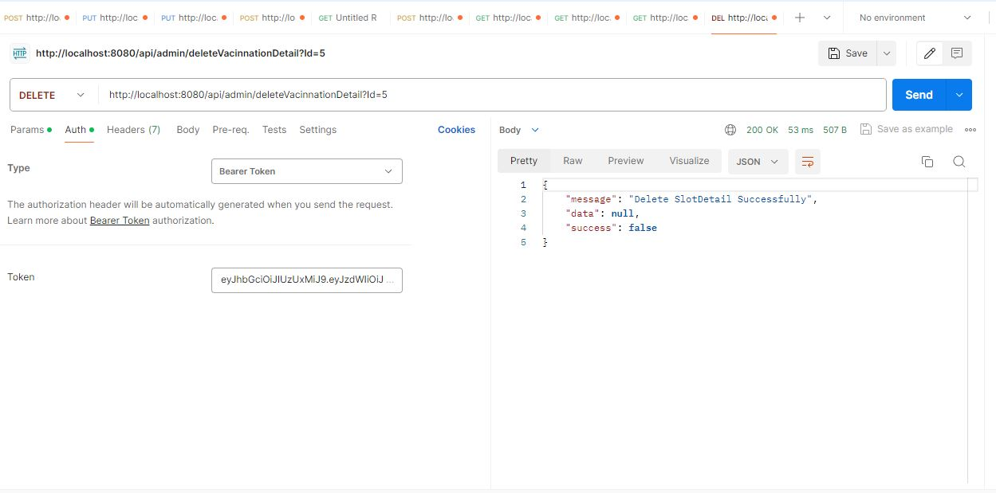

Slide 24
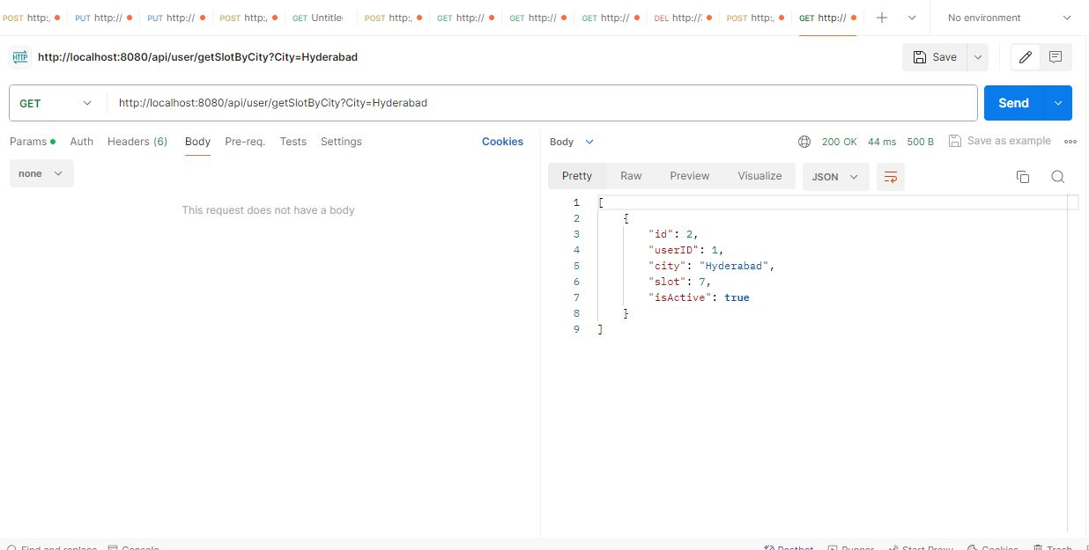

Slide 25
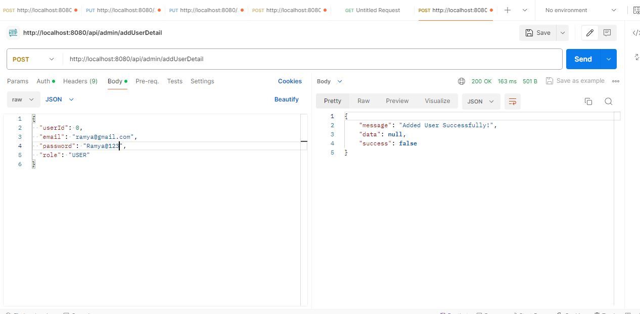

Slide 26
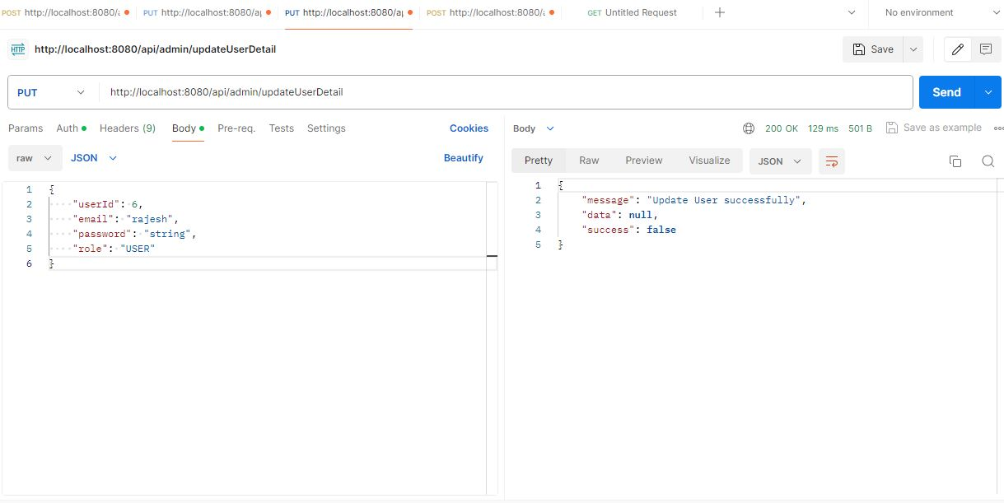

Slide 27
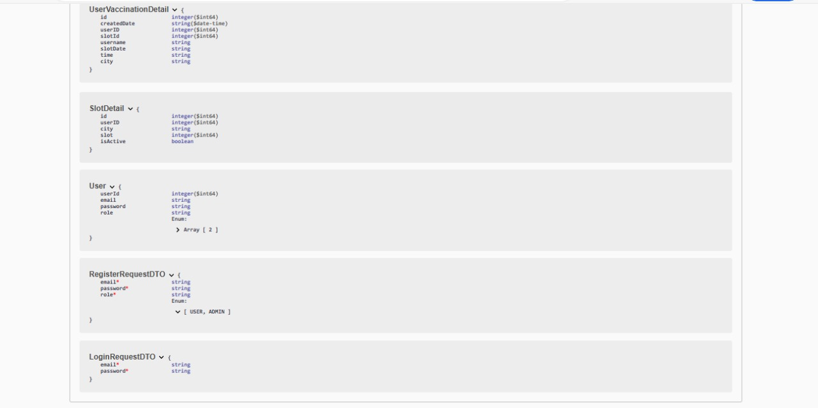
Schemas

Slide 28
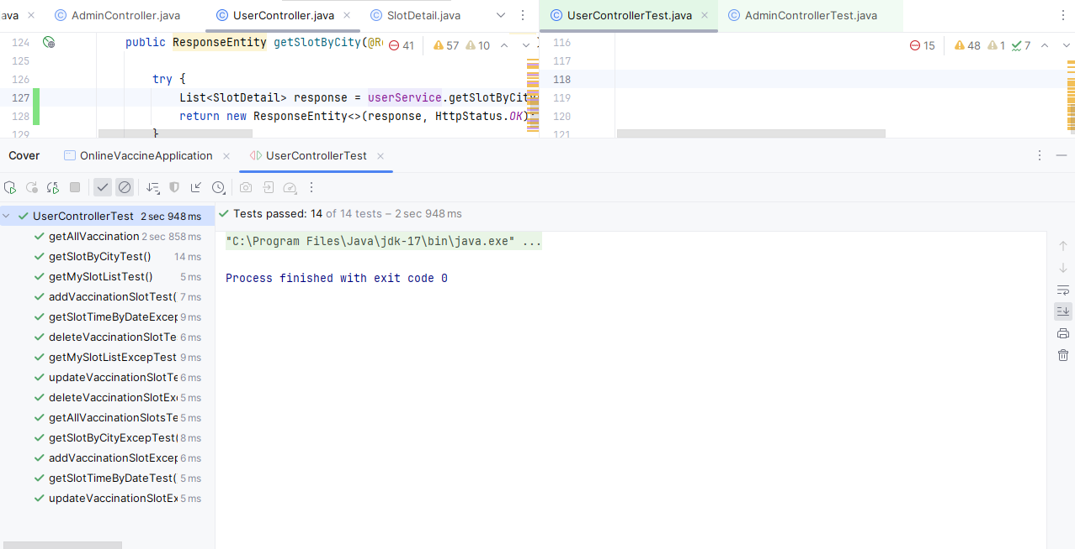
JUNIT Test Cases

Slide 29
CONCLUSION
Seamless Updates: Effortless system maintenance for administrators to keep vaccine inventory accurate.
Effortless Management: User-friendly interface simplifies tasks like adding, updating, and deleting vaccine information.
User-Friendly Interface: Intuitive platform for accessing critical vaccine and customer information.
Innovative Search and Display: Empowers users with an intuitive platform to browse and select suitable vaccine options.

Slide 30


